Slide 1
Optimizers in Machine Learning
Luca Mezger
06.12.2024
Gymnasium Thun, Matura Thesis
Notes:
Welcome…
Who has heard of ML/AI? Who has a basic understanding on how it works?
So my aim is to reduce this knowledge gap and explain the concept of optimizers → finally show my results of maturathesis
Which I conducted at MIT, research program, under direction of phd student and a professor
Sadly can’t go into detail, end give more information

Slide 2

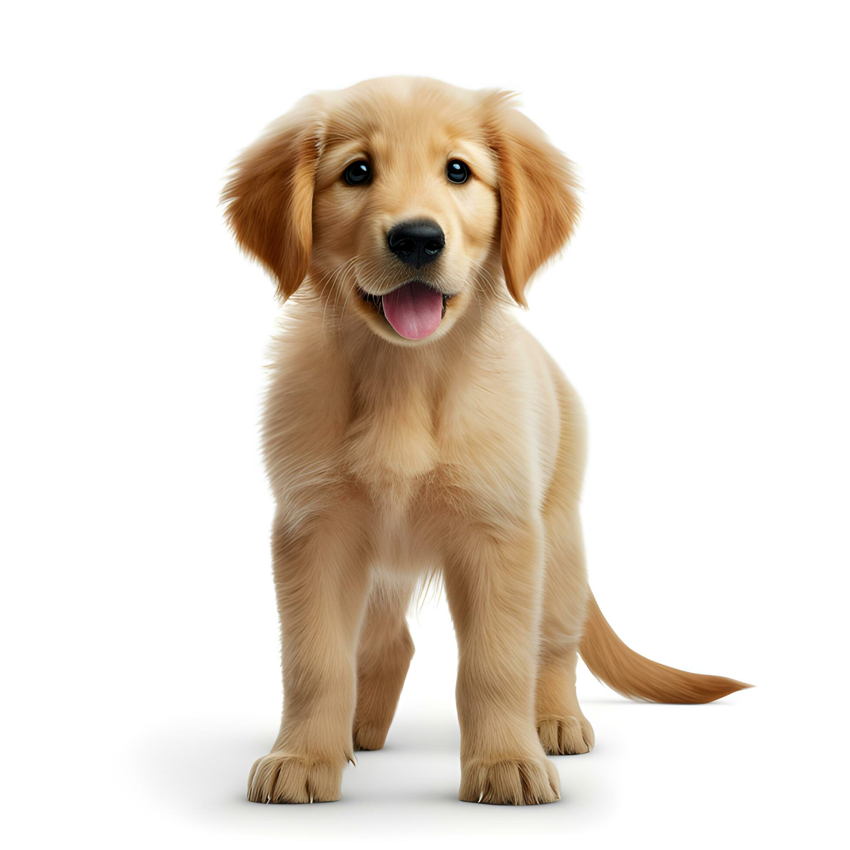
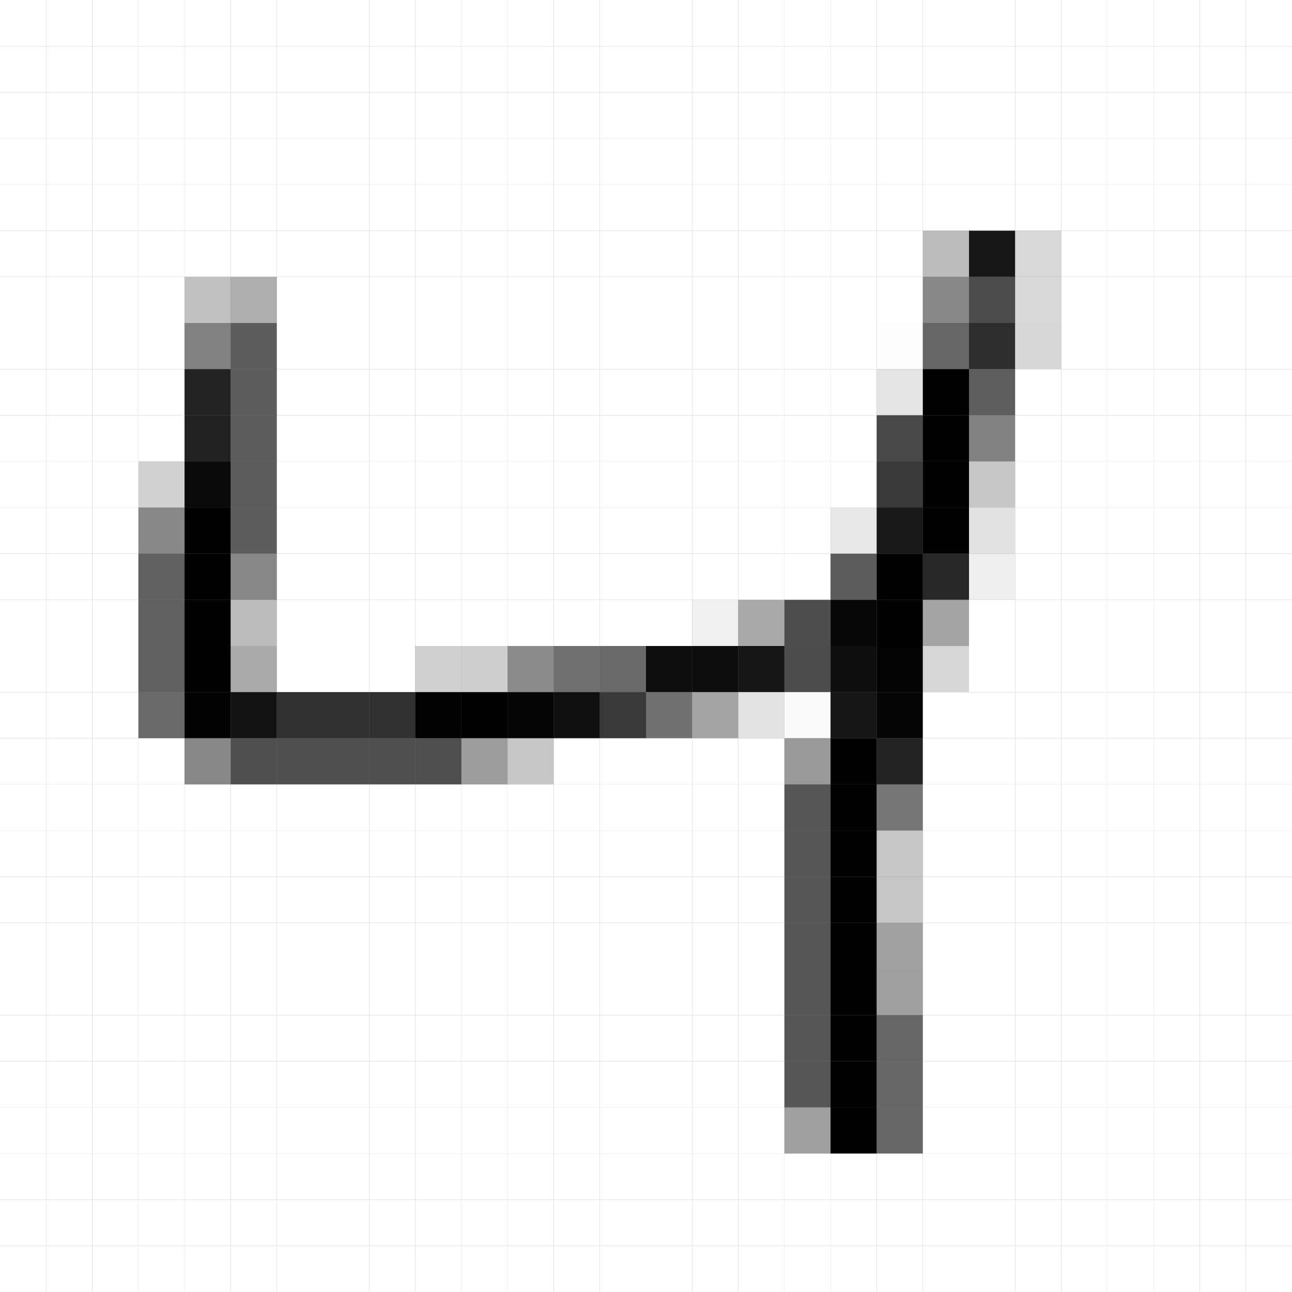
Machine Learning Models
Cat
Dog
Cow
…
4
Notes:
Imagine a big black box with knobs and dials
Inputs and outputs, pixel of dog
classifier
We want to adjust these knobs and dials that on a given input we receive an output we desired
> e.g. chatgpt, prompt → answer
→ somehow these knobs and dials manipulte the data

Slide 3
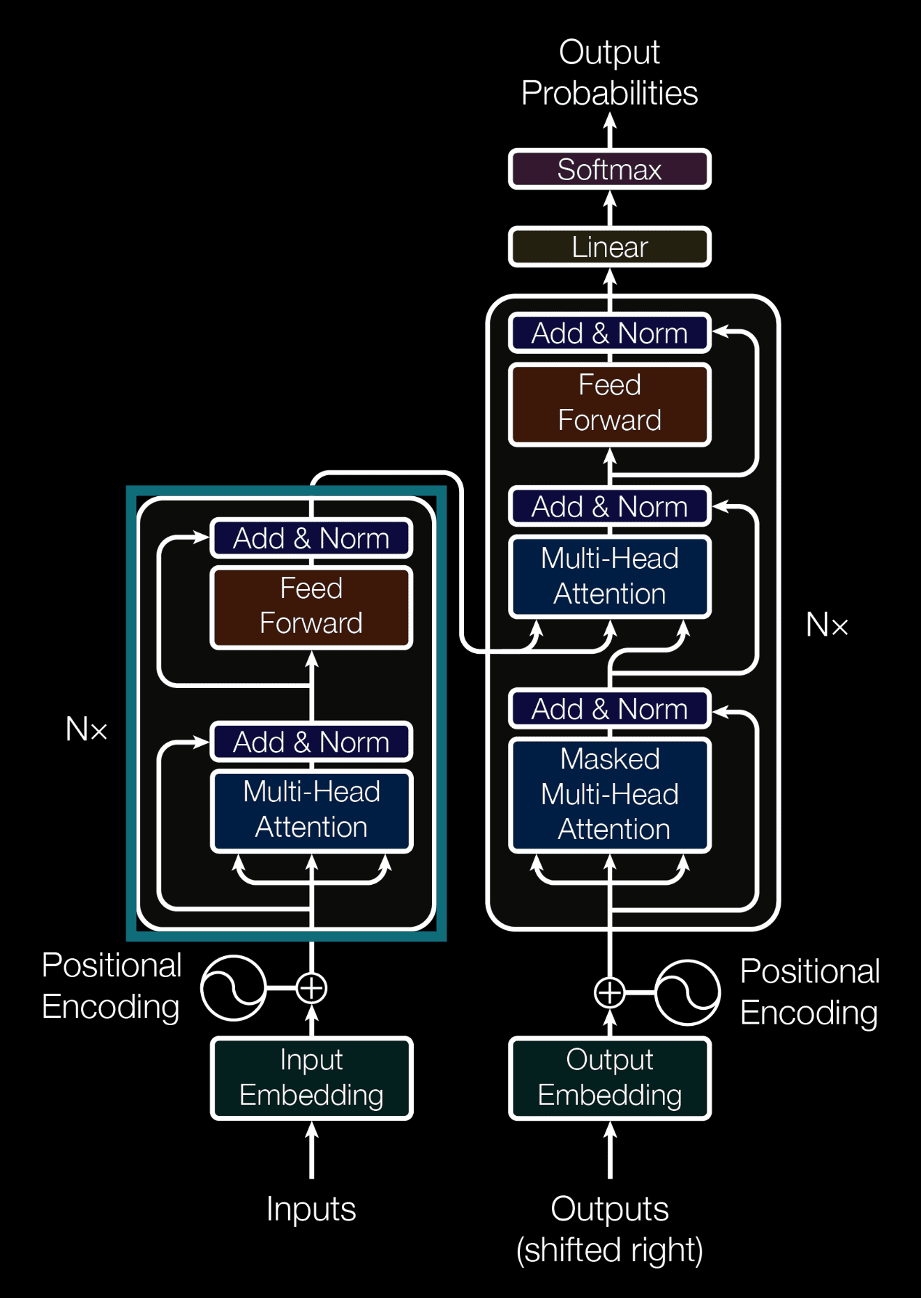
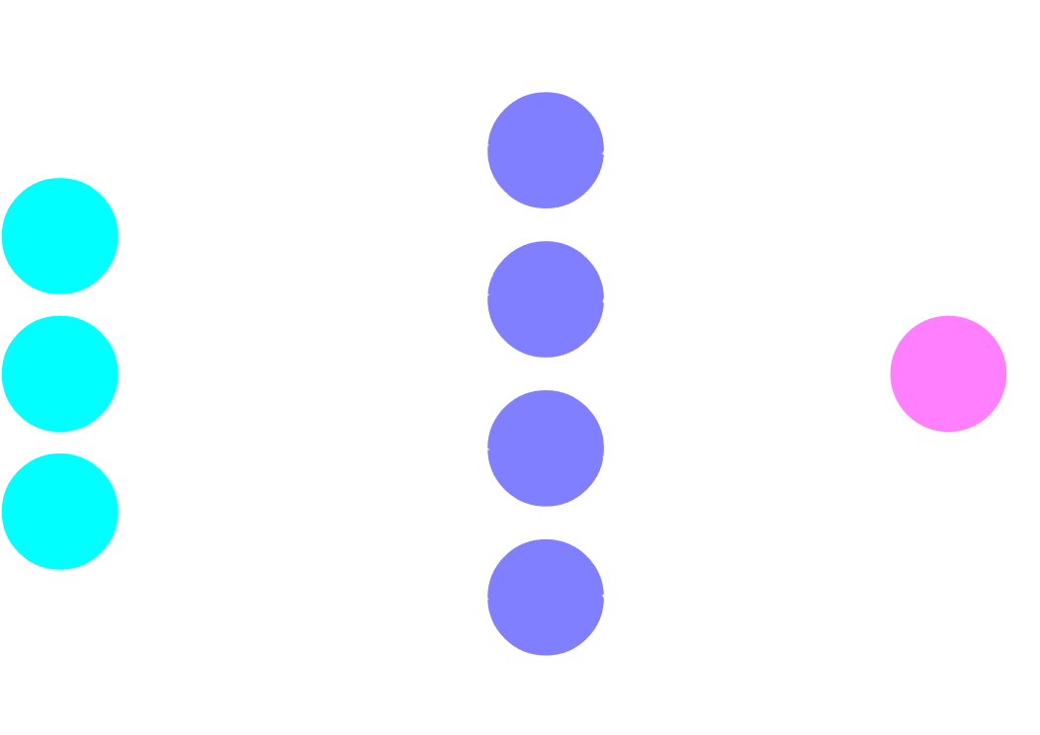
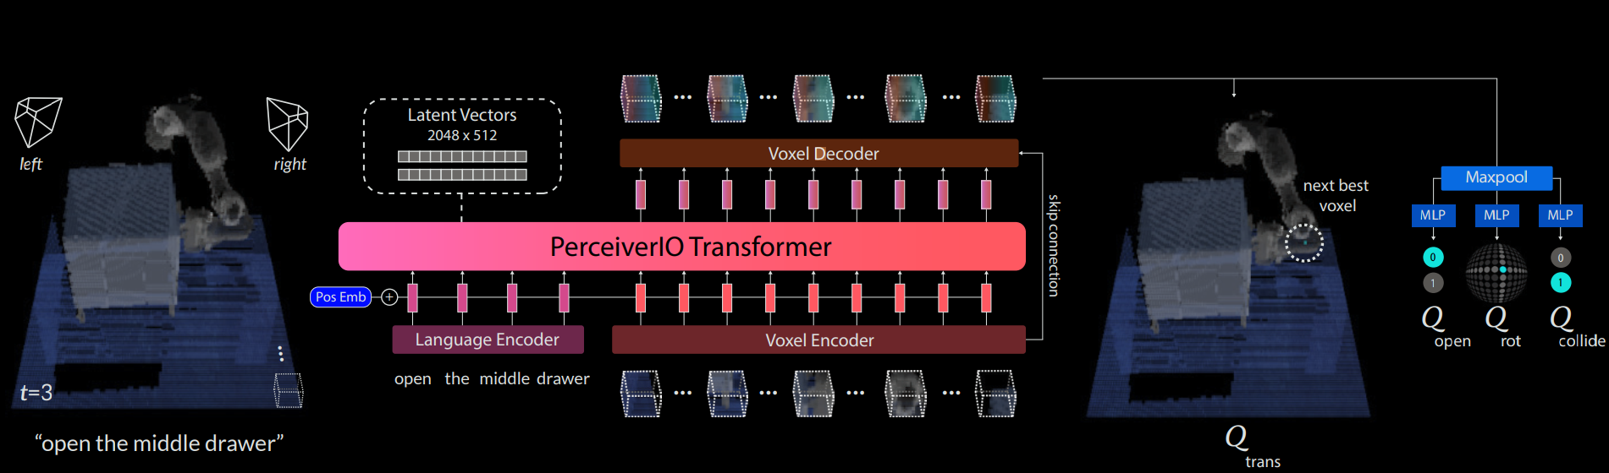
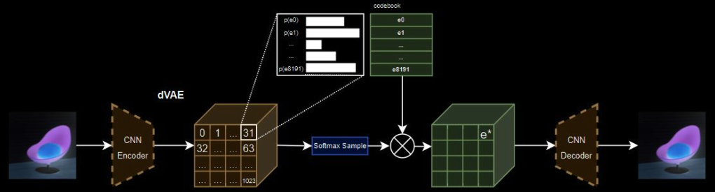
Notes:
Complicated not the focus of this presentation
MLP (Neural Network)
Discrete Variational Autoencoder (dVAE) → used in Dallee
PerceiverIO → Computer Vision, Object manipulation
Transformer model (used in GPT2)
https://arxiv.org/pdf/2209.05451
https://miro.medium.com/v2/resize:fit:1400/0*yosQ9u0cmtipniHZ
https://machinelearningmastery.com/wp-content/uploads/2021/10/transformer_1.png

Slide 4
How do Machine Learning Models work?
Cat
Dog
Cow
…
4
Notes:
Most probably, output is wrong on random knobs and dials
Entire research → how can we make these adjustments.

Slide 5
How do Machine Learning Models work?
Cat
Dog
Cow
…
4
Notes:
Entire research → how can we make these adjustments.

Slide 6

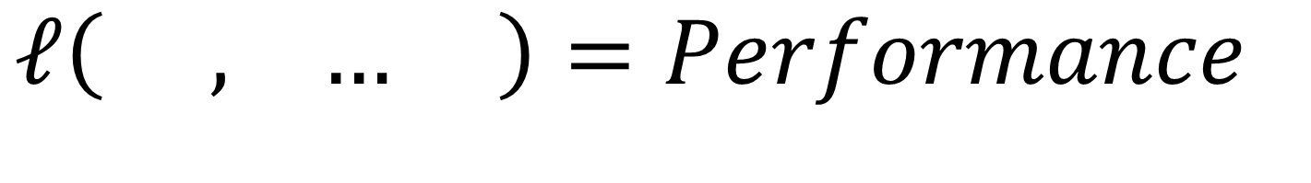
Loss Function
$ℓ\left( , … \right)=Performance$
Notes:
Bear with me, not too much math
How good is the model, loss = high
Go back slides and explain, how to calculate this loss depends on the model itself
Adapt our previous goal from “adjusting these knobs and dials” to minimizing the loss function.

Slide 7
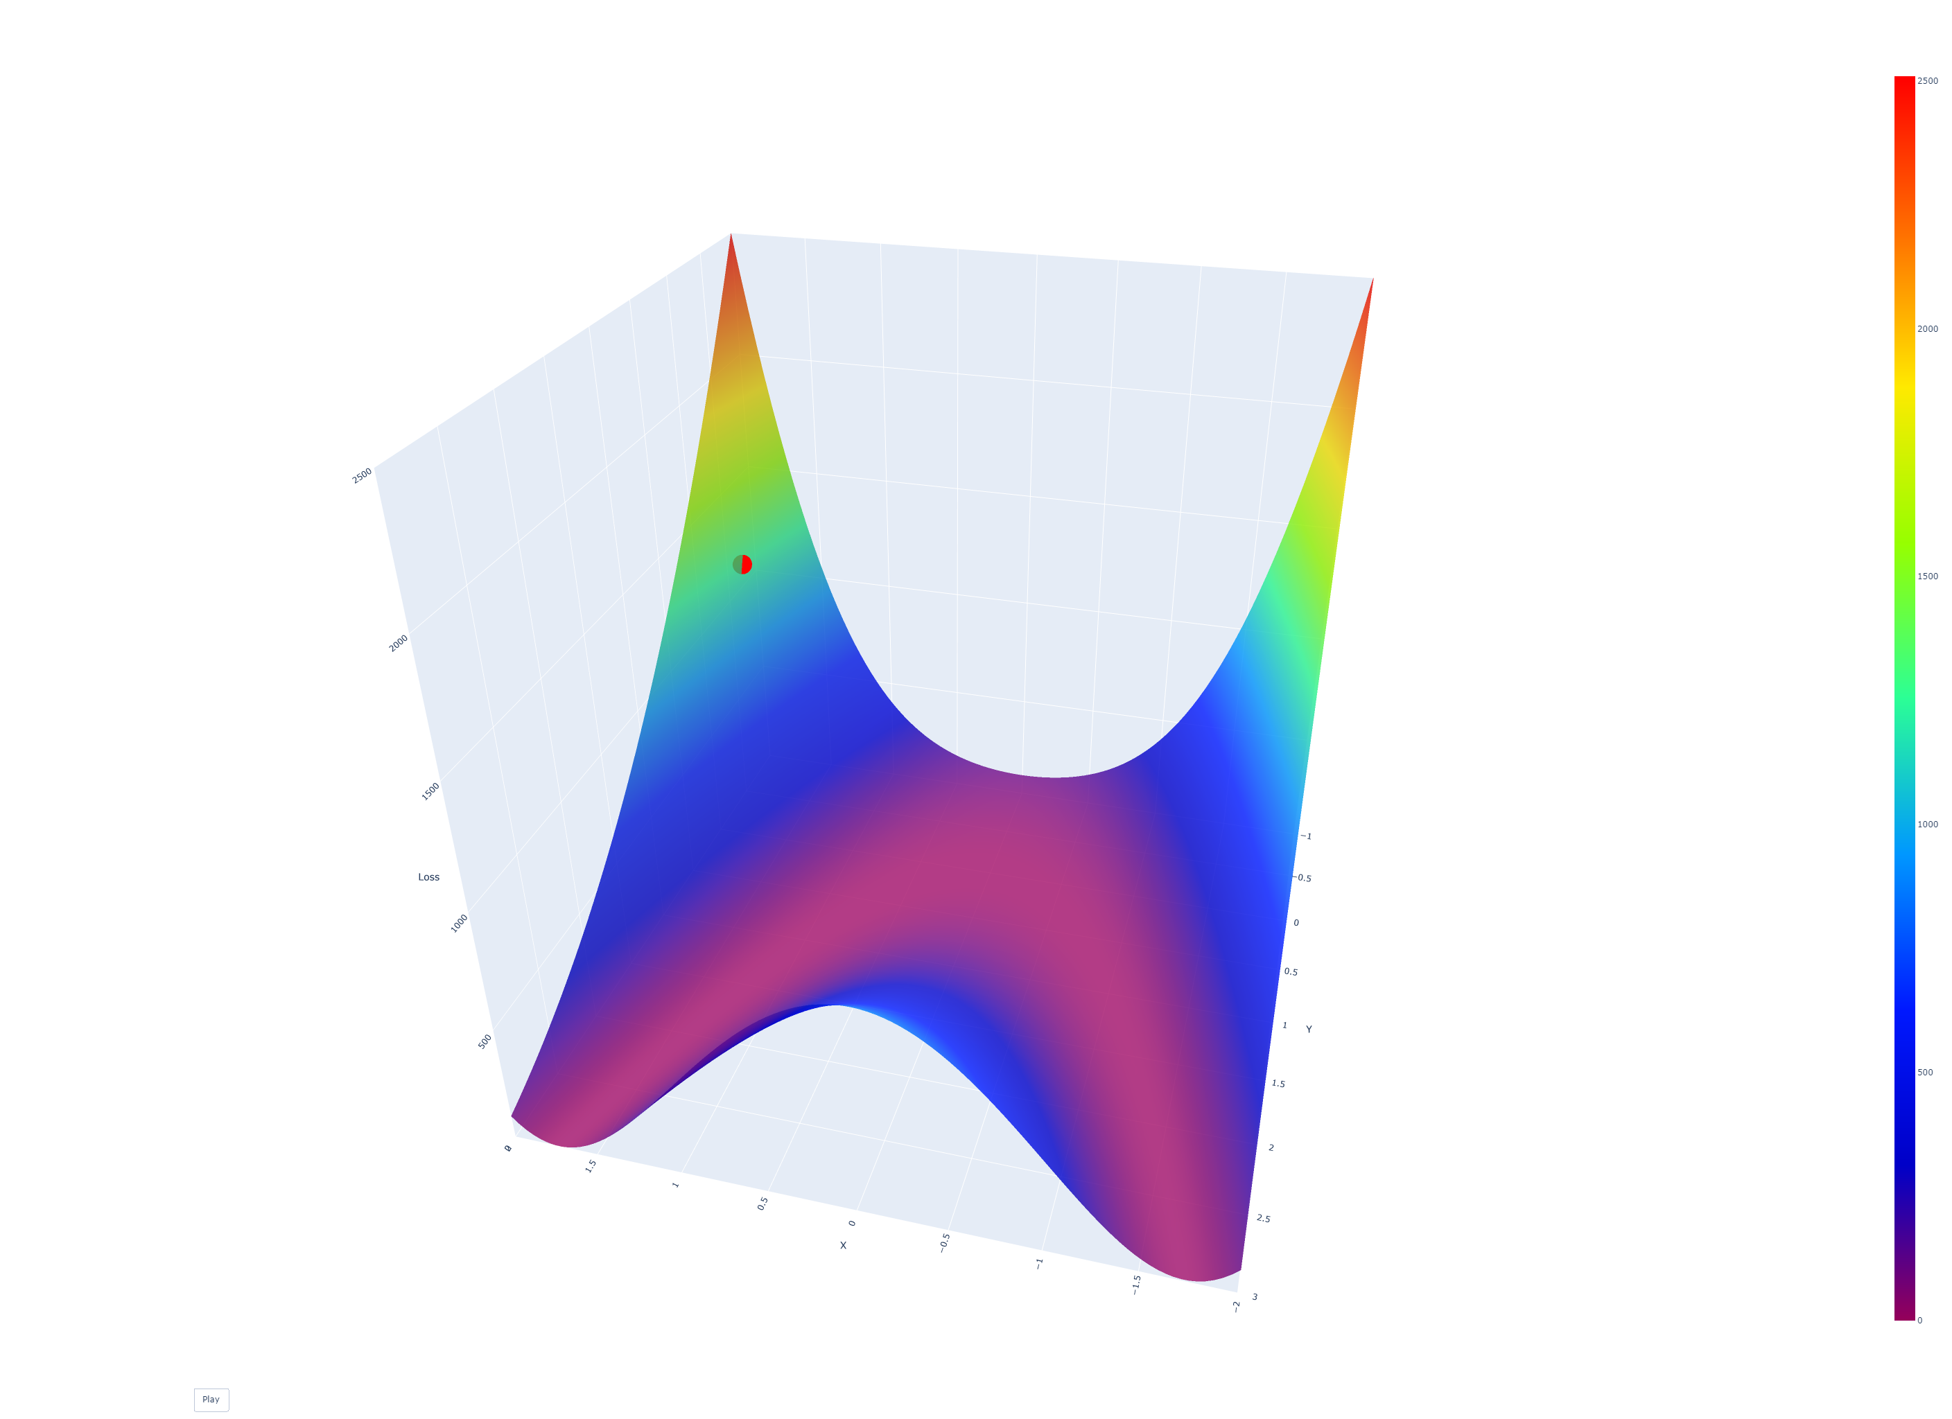













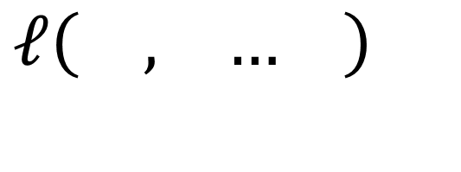

Loss Function
$ℓ\left( , … \right)$
$$1$$
$$2$$
$$n$$
$$2$$
0,0
$$1$$
Notes:
Adapt our previous goal from “adjusting these knobs and dials” to minimizing the loss function.
iteration
Obvious: set derivative = 0 / match it by eye→ not possible
No information → imagine hiking down from a mountain at night
Link back to the model previously, we can see how to set our parameters
Train, learn model, trainieren

Slide 8
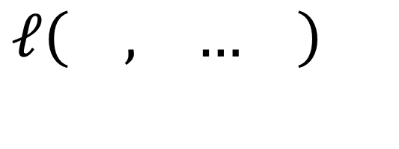




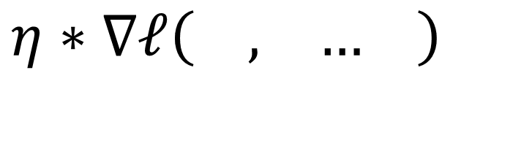








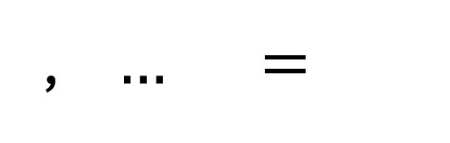


Loss Function
$ℓ\left( , … \right)$
$$1$$
$$2$$
$$n$$
$$2$$
0,0
$η∗∇ℓ\left( , … \right)$
, $… =$
, $… −$
$$1$$
$$2$$
$$n$$
$$1$$
$$2$$
$$n$$
$$1$$
$$2$$
$$n$$
$$1$$
Notes:
This equal is not a mathematical equal but assigning the variable a new value
Learned SGD
WE CALL THESE PROCESSES/FORMULAS → Optimizers!!! (that’s the whole crux of my presentation, you know what optimizers in machine learning are)
That’s what we call training/learning in a ML model

Slide 9
Loss Function
$ℓ\left( , … \right)$
$$1$$
$$2$$
$$n$$
$$2$$
0,0
$$1$$
Notes:
Now if we go back and we log every optimization step, so the loss value at the iteration step we get a graph
Even here not the optimal path → better optimizers?

Slide 10
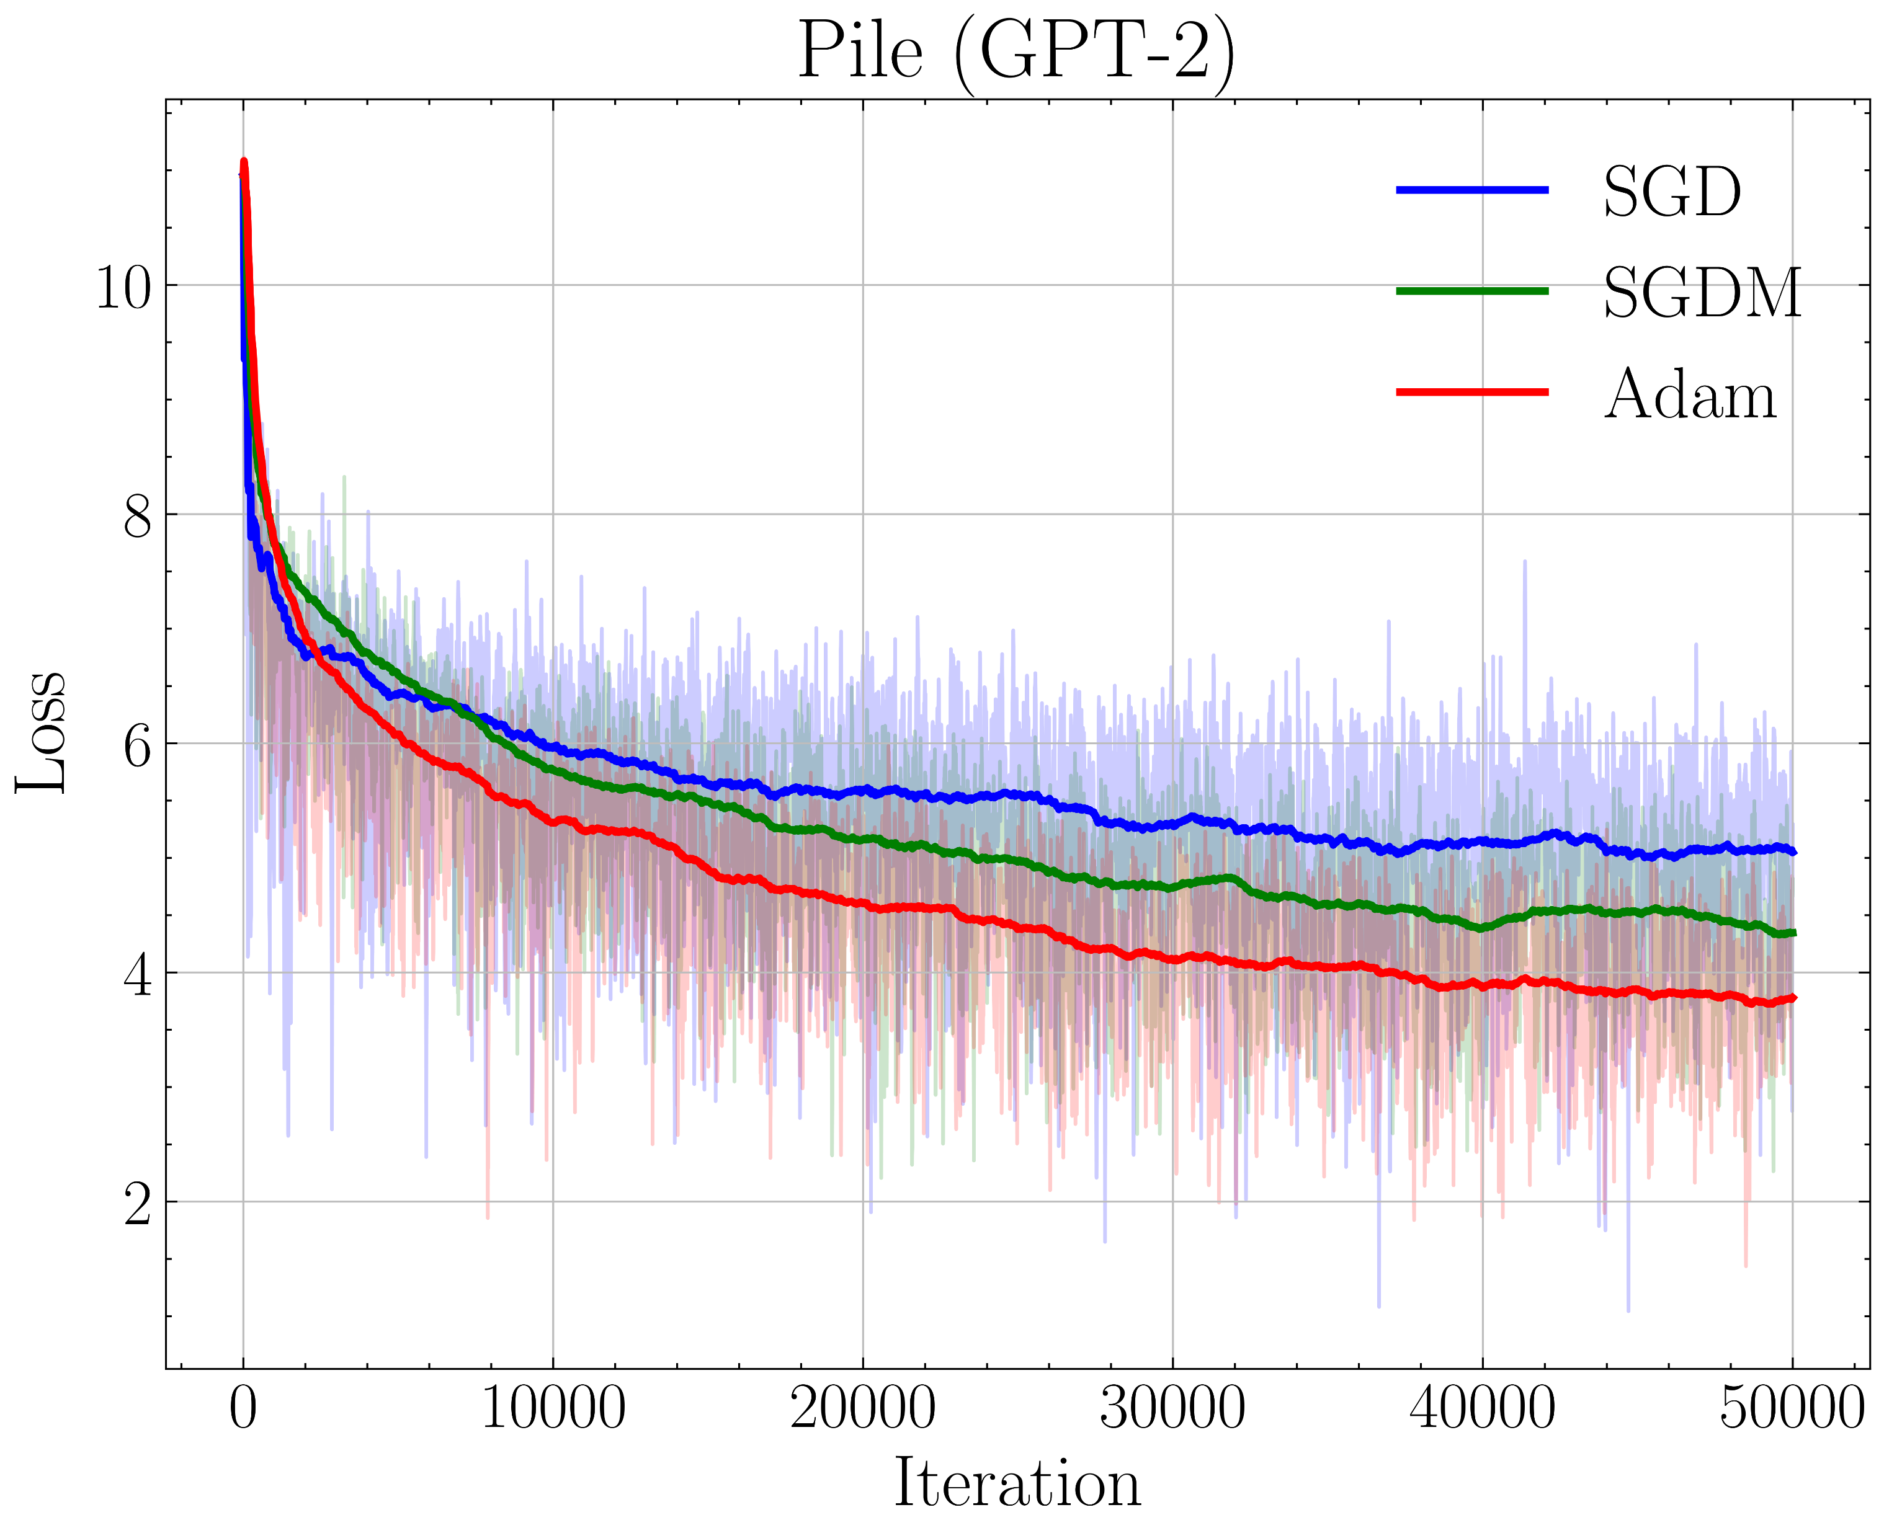
Analyzing Optimizers
Notes:
See difference in
Trained on GPT-2 Model, not surface plot to minimize but loss function of a GPT-2 Model
Adam better

Slide 11
Why?
Better Optimizer
Less Resources or Data needed
Cheaper / Better Models
Notes:
Save a lot of money (billions of CHF), save a lot of energy and CO2
Don’t have to mention the importance of ML/AI
→ don’t think I have to mention the importance of AI, if you’re not sure PLEASE ask
40’000 Megawatts → 10’000 tons of CO2 in the USA
Total Power Consumption per GPU:
Power per hour = 350 watts = 0.35 kW.
Power per day = 0.35 kW * 24 hours = 8.4 kWh.
Total Power Consumption for 40,000 GPUs:
Power per day = 40,000 GPUs * 8.4 kWh = 336,000 kWh (336 MWh) per day.
Power for 150 days = 336 MWh/day * 150 days = 50,400 MWh.
Carbon Emission Estimate (assuming average global grid mix, 0.5 kg CO2 per kWh):
https://news.mit.edu/2024/cutting-carbon-emissions-us-power-grid-0311#:~:text=For%20context%2C%20the%20current%20U.S.,CO2%20emissions%20per%20kWh.

Slide 12
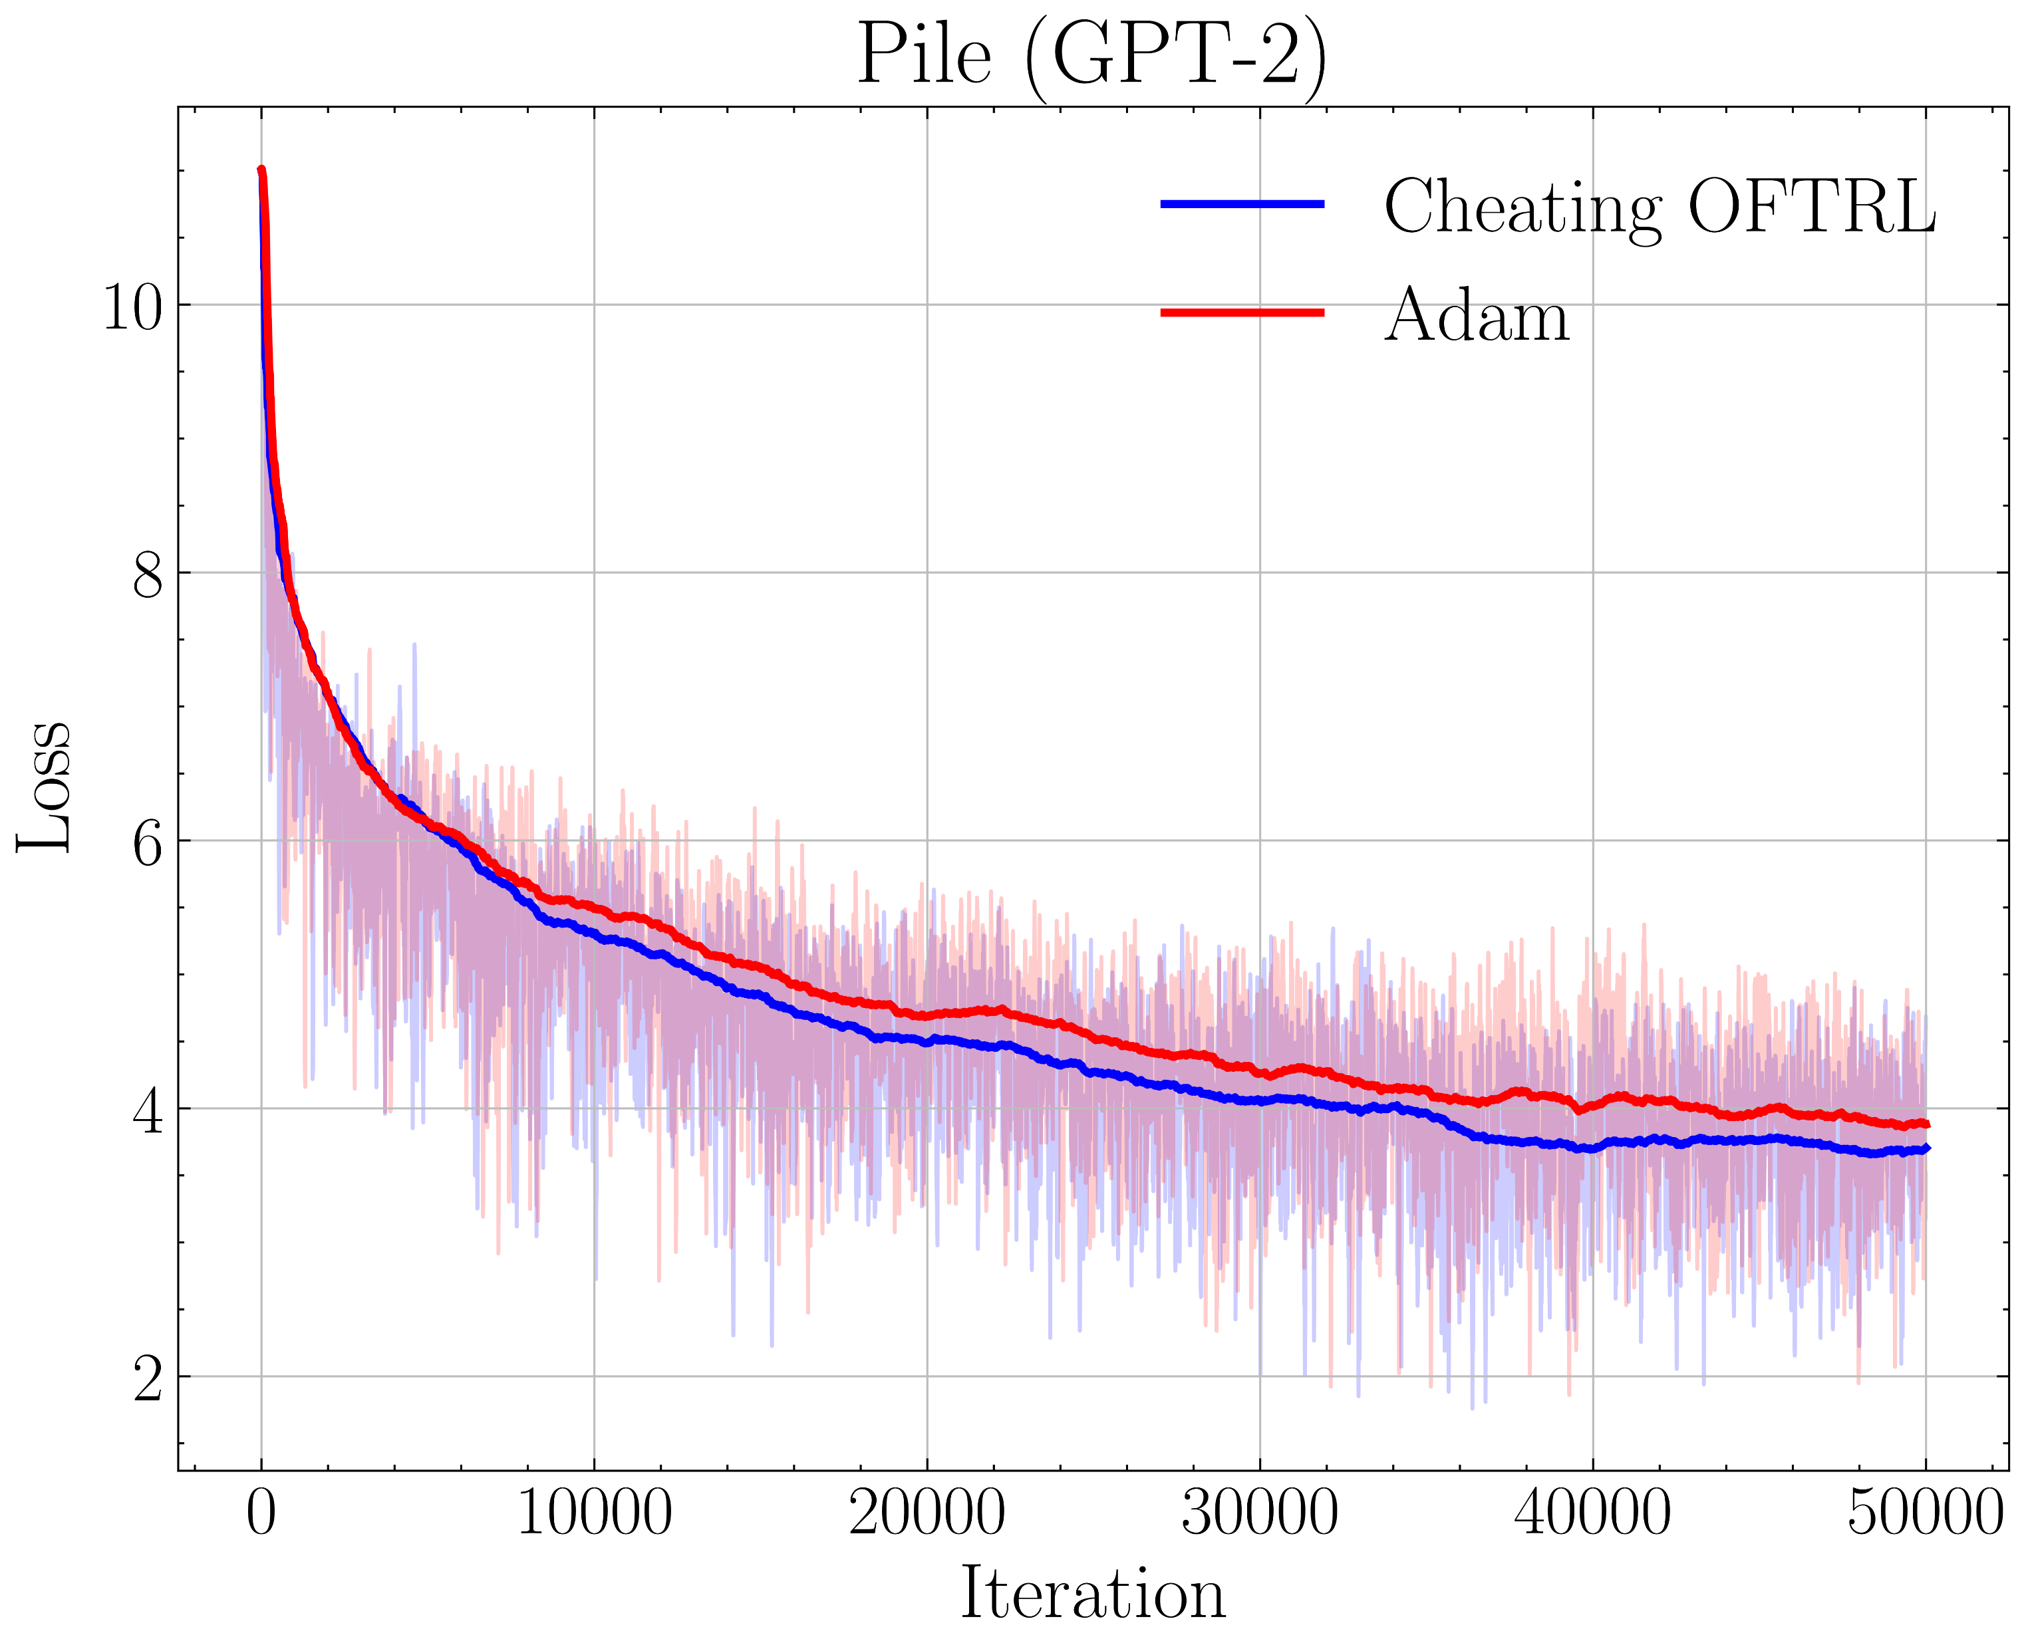
Predictive Hints
Notes:
Adam benchmark
My version is better
If actually I wouldn’t be here, but I’d be rich and definitely not here at a highschool anymore → somewhere in Bali at the Beach
Enormous Potential
Very little improvement? → huge implications, better models, less resources

Slide 13
Thank you!
Any Questions?
Luca Mezger | lucamezger.com/ma
06.12.2024
Gymnasium Thun, Matura Thesis
Notes:
Sadly no time
Thank you very much and I hope I could introduce you to KI and Optimizers
website

Slide 14
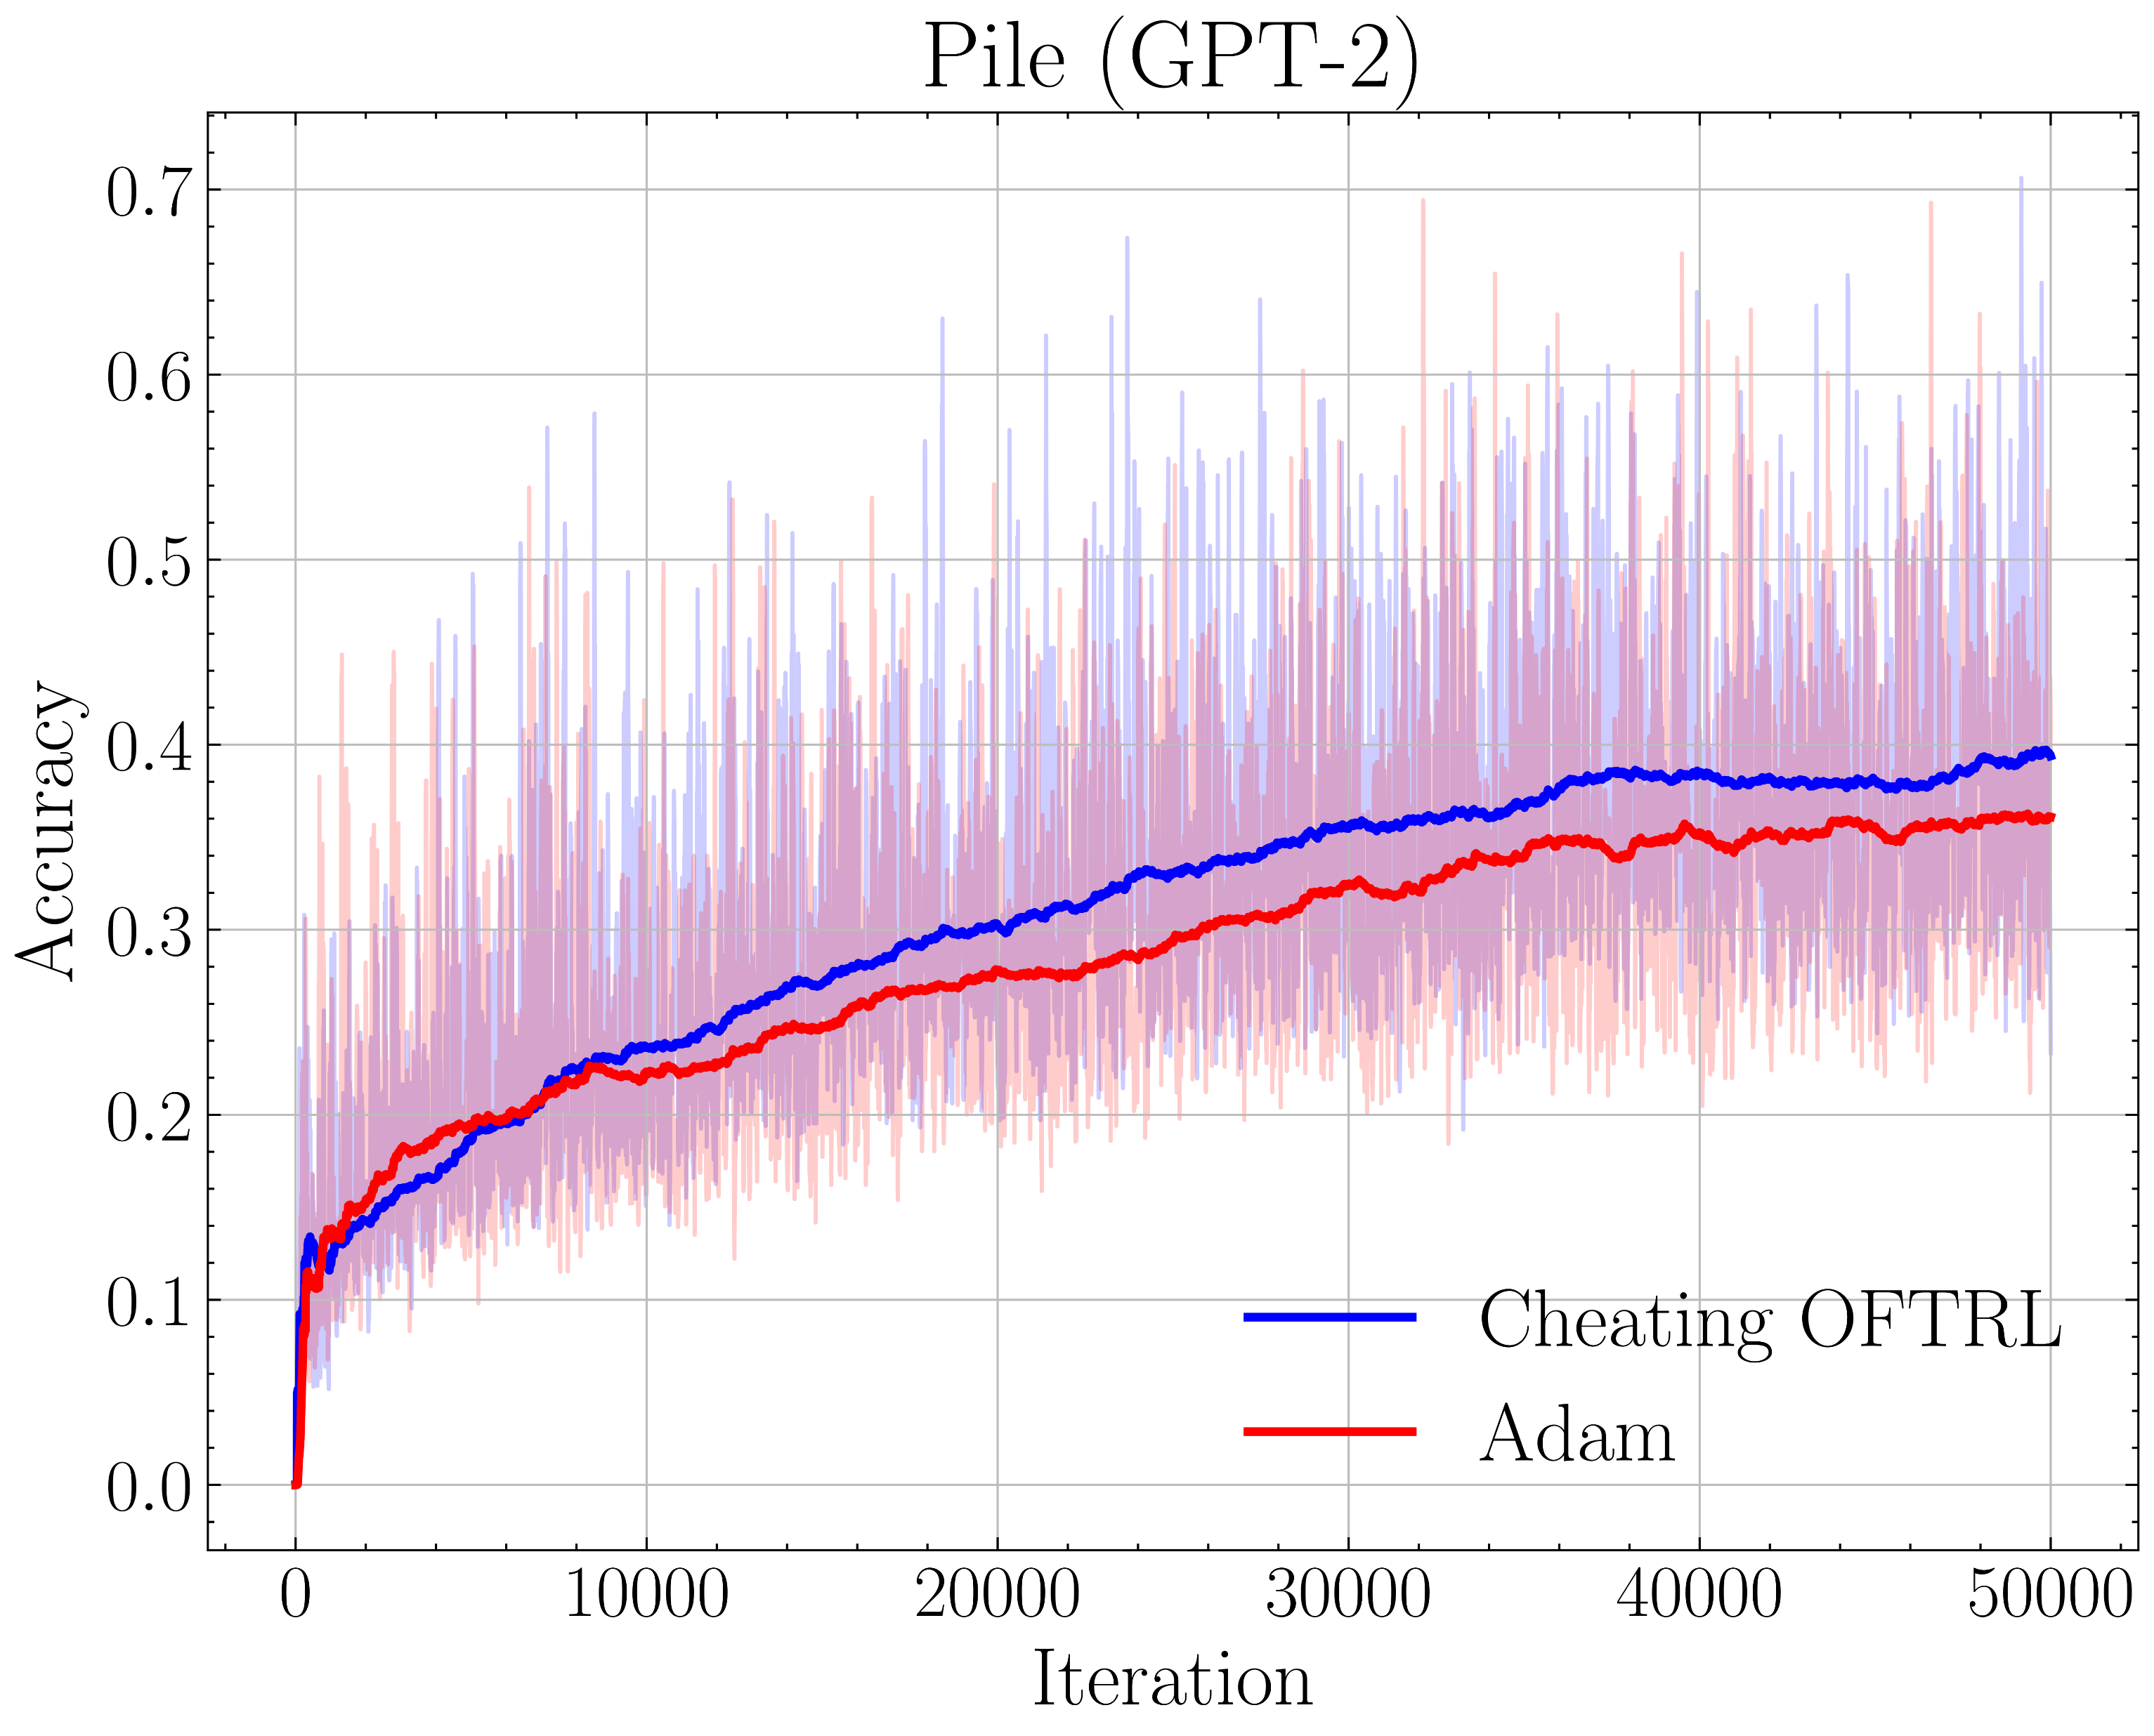
Predictive Hints

Slide 15
Difficulties with Optimization
Non-differentiable points
Noisy loss function
Local Minima and Saddle points
Vanishing / Exploding Gradients
High dimensionality
Hyperparameter Tuning
Big dataset
Sparse data

Slide 16
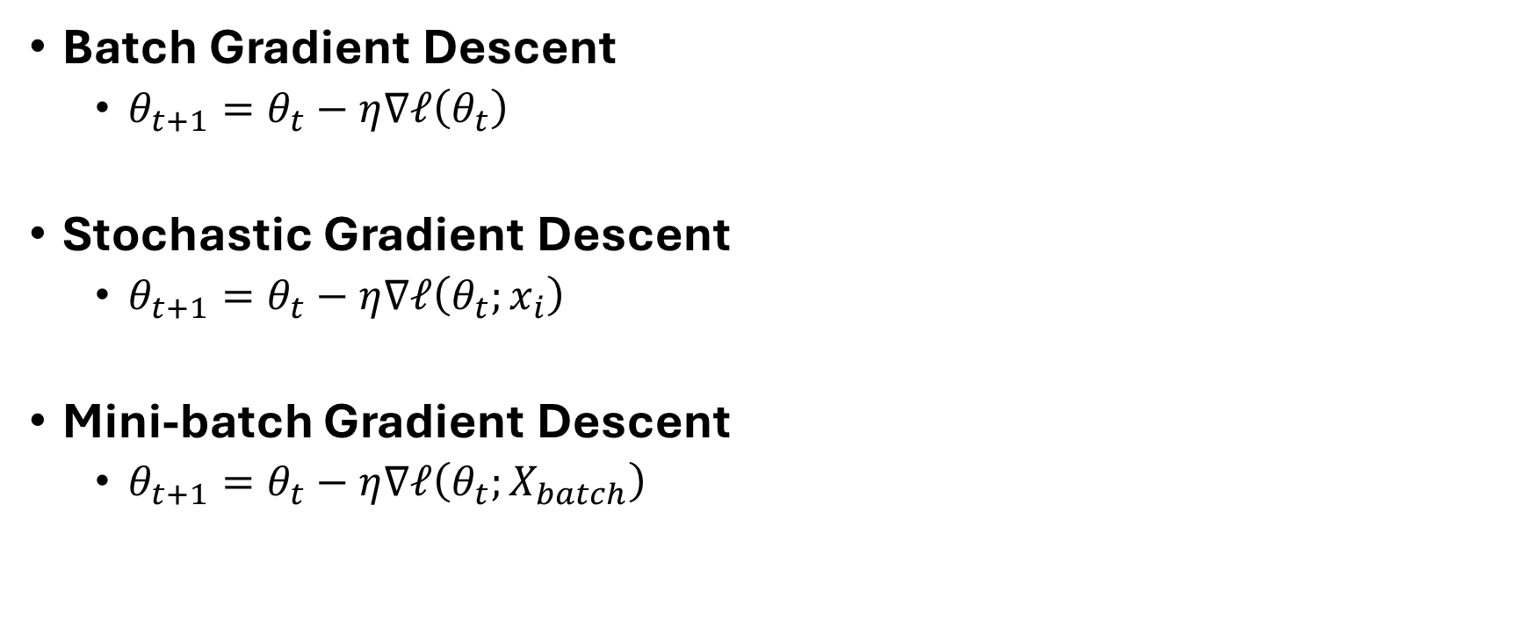
BGD vs. SGD vs. MGD
Batch Gradient Descent
  $θ_{t+1}=θ_{t}−η∇ℓ\left(θ_{t}\right)$
Stochastic Gradient Descent
  $θ_{t+1}=θ_{t}−η∇ℓ\left(θ_{t};x_{i}\right)$
Mini-batch Gradient Descent
  $θ_{t+1}=θ_{t}−η∇ℓ\left(θ_{t};X_{batch}\right)$
Notes:
Batch Gradient Descent
- Stable updates but computationally expensive for large datasets
Stochastic Gradient Descent (x_i is a vector)
- Faster updates, noisy updates, less stable
Mini-batch Gradient Descent (X is matrix of vectors
- balances stability and efficiency

Slide 17
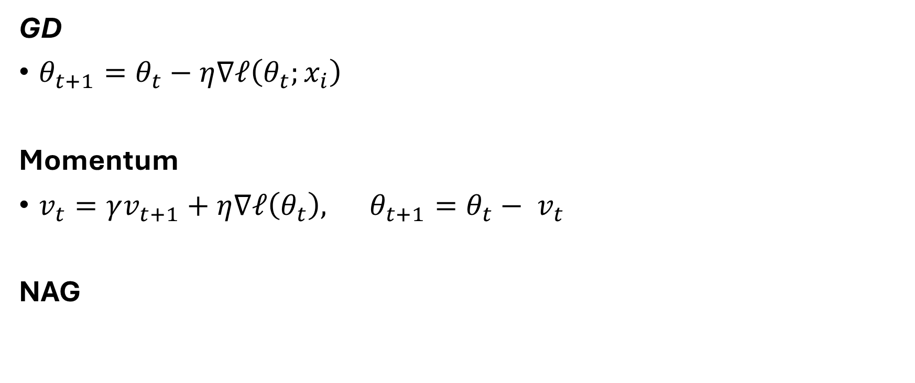
Advanced Optimizers 1
GD
$θ_{t+1}=θ_{t}−η∇ℓ\left(θ_{t};x_{i}\right)$
Momentum
$v_{t}=γv_{t+1}+η∇ℓ\left(θ_{t}\right), θ_{t+1}=θ_{t}− v_{t}$
NAG
Notes:
Nesterov Accelerated Gradient (NAG):

Slide 18
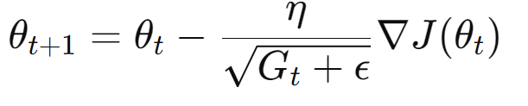
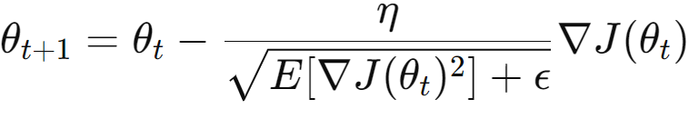
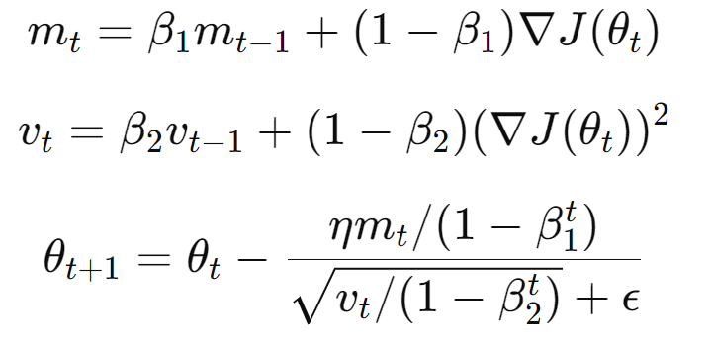
Advances Optimizers 2
RMSprop
AdaGrad
Adam
…

Slide 19
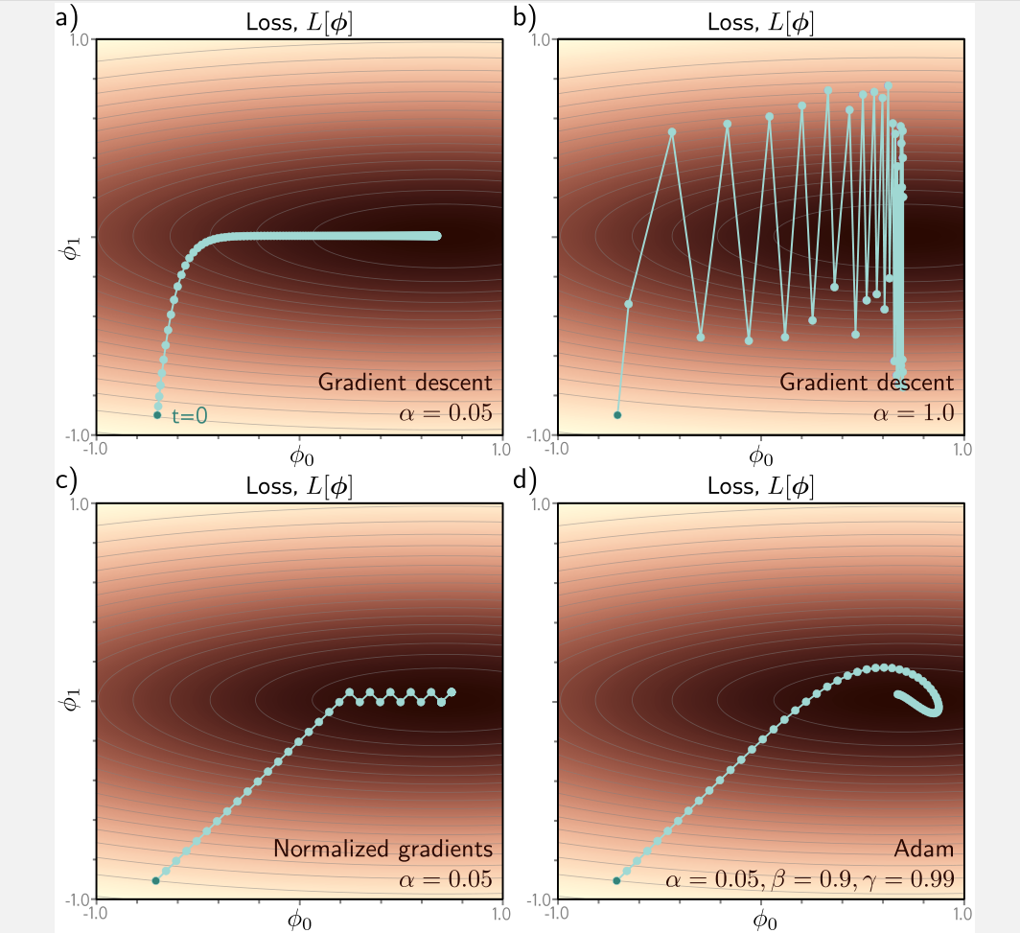
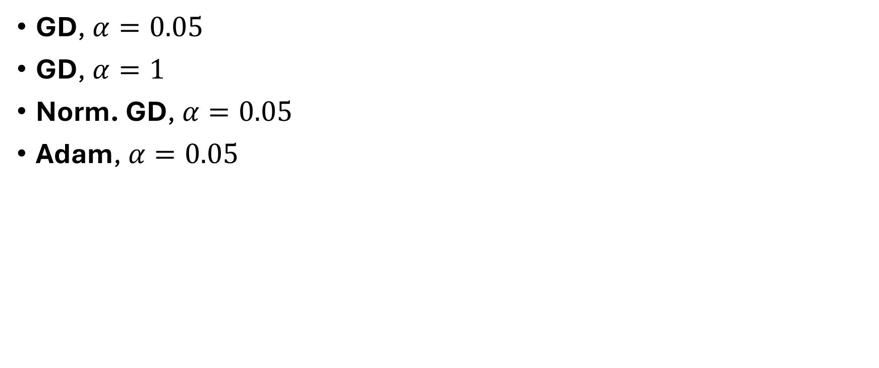
Optimizers
GD, $α=0.05$
GD, $α=1$
Norm. GD, $α=0.05$
Adam, $α=0.05$

Slide 20
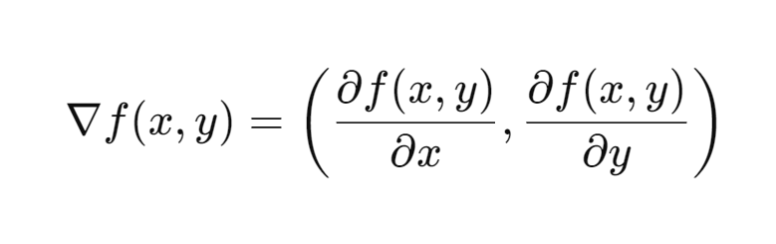
Partial differential Equations (2d input)

Slide 21
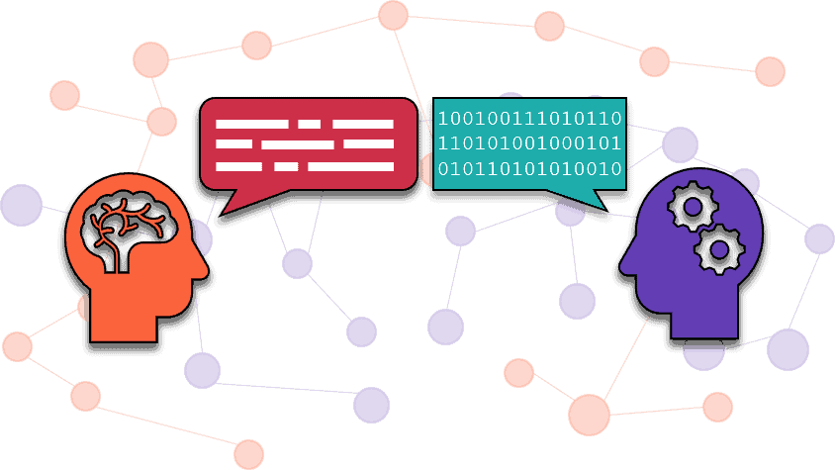
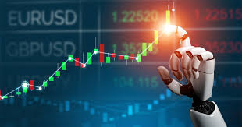
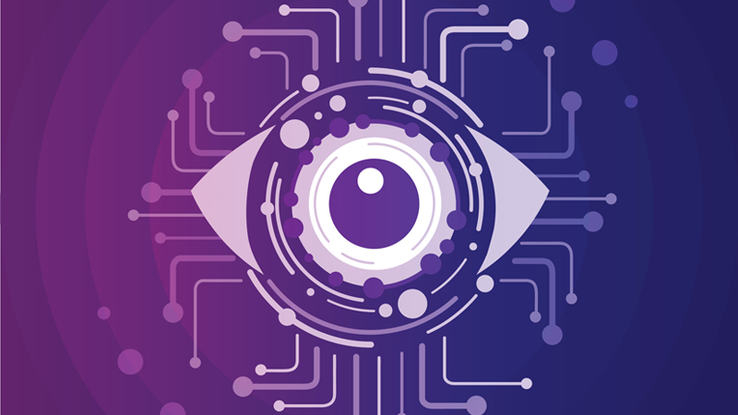

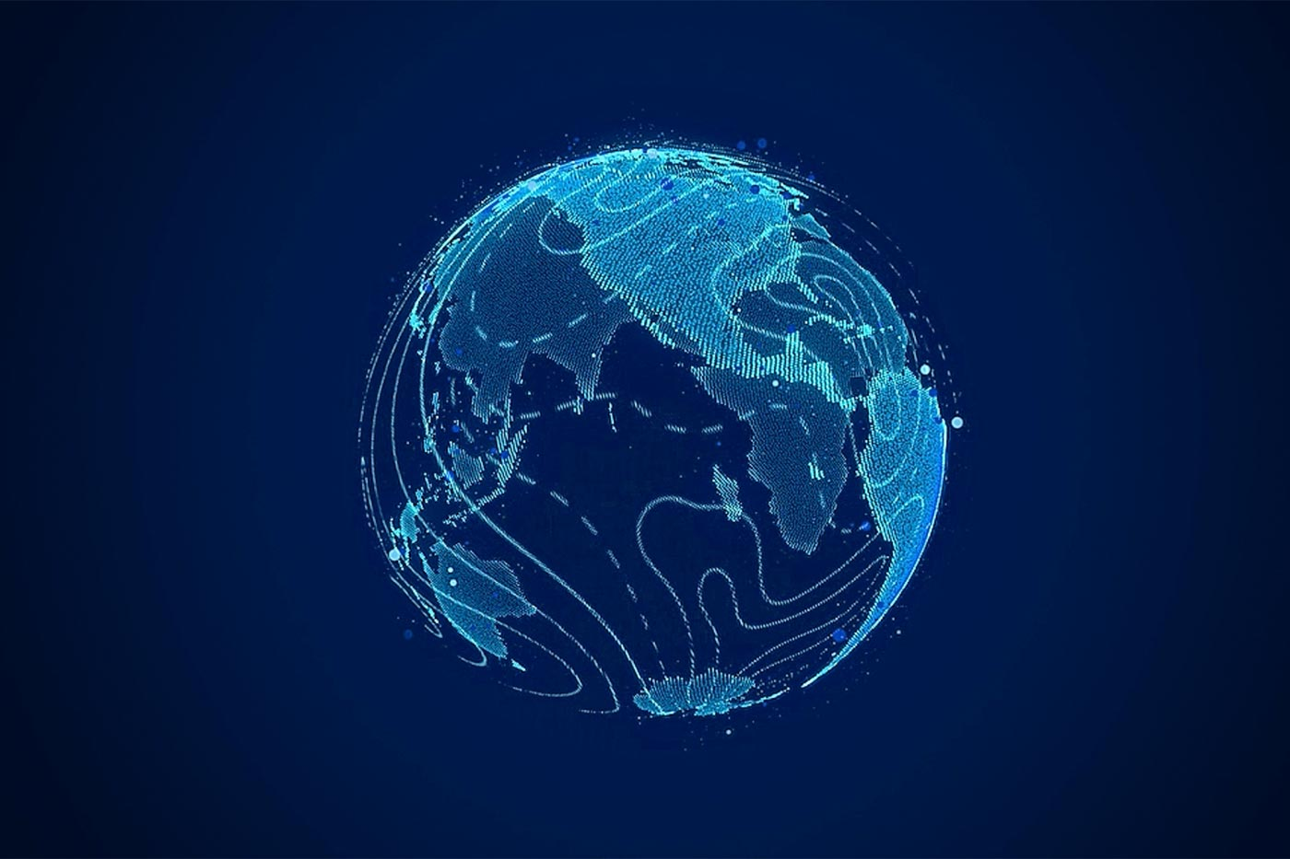
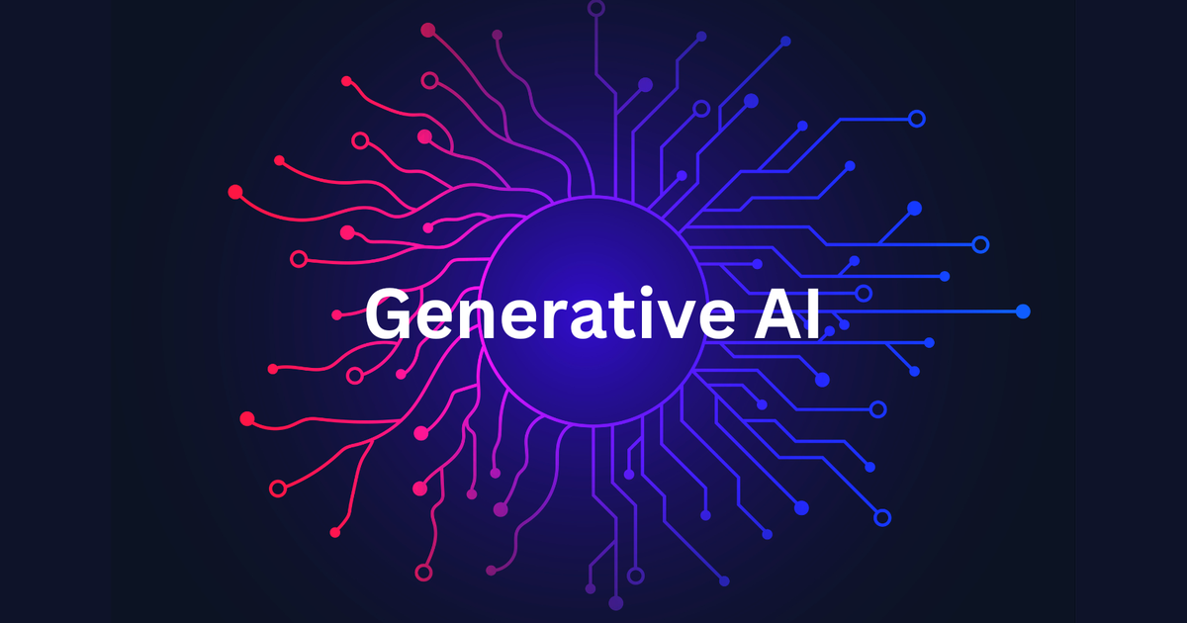
Applications of ML
Notes:
Computer Vision:
Object detection
Automatic Cars
Passport control
Handy camera
Natural Language Processing
ChatGPT
Siri
Automatic Captions (e.g. for deaf people)
Translation
Generative AI
Image generation
Text generation
Song generation
Personalized Content
Recommender Systems
Netflix
Ads
Spotify
Healthcare
Medical imaging (x rays)
Predictive analysis
Drug discovery
Robotic surgery
Personalized treatment
Finance
Fraud detection
Algorithmic trading
Risk management
Many More like weather forecasting…
https://aibusiness.com/nlp/what-is-generative-ai-and-how-is-it-different-from-other-ai-
https://www.telusinternational.com/insights/ai-data/article/computer-vision-through-the-ages
https://navigate360.com/blog/what-is-natural-language-processing/
https://www.weathercompany.com/blog/ai-in-weather-forecasting-prediction-and-communication/
https://www.activestate.com/blog/machine-learning-healthcare-theory-practice/
https://www.netsuite.com/portal/resource/articles/financial-management/financial-forecast-machine-learning.shtml
Here’s a concise list of AI/ML applications across various domains:
### Healthcare
- **Medical Imaging**: Automated diagnosis (e.g., detecting tumors in X-rays/MRIs).
- **Predictive Analytics**: Disease prediction and patient outcome forecasting.
- **Drug Discovery**: Identifying potential compounds for new drugs.
- **Personalized Medicine**: Tailoring treatment plans based on patient data.
- **Robotic Surgery**: Assisting surgeons with precise, minimally invasive procedures.
### Finance
- **Fraud Detection**: Identifying suspicious transactions in real-time.
- **Algorithmic Trading**: Automated trading strategies using predictive models.
- **Credit Scoring**: Assessing creditworthiness based on financial data.
- **Risk Management**: Analyzing market data to manage financial risks.
- **Customer Service**: AI-powered chatbots for banking and finance queries.
### Retail
- **Recommendation Systems**: Personalized product suggestions (e.g., Amazon, Netflix).
- **Inventory Management**: Predicting demand to optimize stock levels.
- **Price Optimization**: Dynamic pricing strategies based on demand and competition.
- **Customer Segmentation**: Analyzing customer data for targeted marketing.
- **Visual Search**: Image-based product search capabilities.
### Manufacturing
- **Predictive Maintenance**: Forecasting equipment failures to prevent downtime.
- **Quality Control**: Automated inspection and defect detection.
- **Supply Chain Optimization**: Enhancing logistics and inventory processes.
- **Robotics**: AI-driven robots for assembly lines and warehouses.
- **Process Automation**: Streamlining production processes through AI.
### Transportation
- **Autonomous Vehicles**: Self-driving cars and drones.
- **Traffic Management**: Predicting and managing traffic flows in real-time.
- **Logistics**: Route optimization for delivery services.
- **Fleet Management**: Monitoring and optimizing vehicle usage.
- **Passenger Experience**: AI-powered ticketing and customer service.
### Agriculture
- **Precision Farming**: Optimizing crop yields with data-driven techniques.
- **Crop Monitoring**: Detecting diseases and nutrient deficiencies in plants.
- **Automated Harvesting**: Robots for picking and sorting crops.
- **Livestock Management**: Monitoring animal health and behavior.
- **Weather Prediction**: AI-driven models for better agricultural planning.
### Energy
- **Smart Grids**: Optimizing energy distribution and consumption.
- **Predictive Maintenance**: Monitoring and maintaining energy infrastructure.
- **Renewable Energy Management**: Forecasting production from solar and wind.
- **Energy Efficiency**: AI-based systems for reducing consumption.
- **Oil and Gas Exploration**: Analyzing geological data to find resources.
### Education
- **Personalized Learning**: Tailoring educational content to individual students.
- **Automated Grading**: AI systems for evaluating exams and assignments.
- **Virtual Tutors**: AI-driven assistance for students.
- **Student Retention**: Predicting and preventing dropouts.
- **Curriculum Development**: Analyzing trends to optimize educational programs.
### Entertainment
- **Content Creation**: AI-generated music, art, and literature.
- **Game Development**: AI for character behavior and game design.
- **Video Streaming**: Personalized content recommendations.
- **Virtual Reality**: AI-enhanced immersive experiences.
- **Social Media**: AI-driven content curation and user engagement analysis.
### Security
- **Surveillance Systems**: Automated monitoring and threat detection.
- **Cybersecurity**: Identifying and mitigating cyber threats.
- **Biometric Authentication**: Face and voice recognition for secure access.
- **Threat Analysis**: Predictive models for security breach detection.
- **Anomaly Detection**: Identifying unusual patterns in network traffic.
### Environment
- **Climate Modeling**: Predicting climate change impacts with AI models.
- **Wildlife Conservation**: Monitoring and protecting endangered species.
- **Natural Disaster Prediction**: Forecasting and managing natural disasters.
- **Sustainable Resource Management**: Optimizing the use of water and energy.
- **Pollution Monitoring**: AI for detecting and reducing pollution levels.
### Government
- **Public Safety**: AI-driven crime prediction and prevention.
- **E-Government Services**: Streamlining public services with AI.
- **Data Analysis**: AI for analyzing large government datasets.
- **Smart Cities**: AI for traffic, waste, and resource management.
- **Policy Making**: Data-driven decision-making tools for governance.
### Sports
- **Performance Analysis**: AI-driven insights into player performance.
- **Injury Prevention**: Predicting and preventing sports injuries.
- **Game Strategy**: AI for optimizing tactics and strategies.
- **Fan Engagement**: Personalized content and interaction for fans.
- **Event Management**: AI for optimizing scheduling and logistics.
This list highlights the diverse and impactful applications of AI/ML across various sectors.

Slide 22
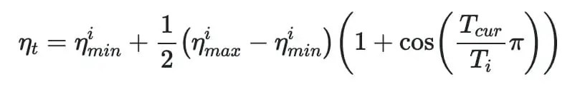
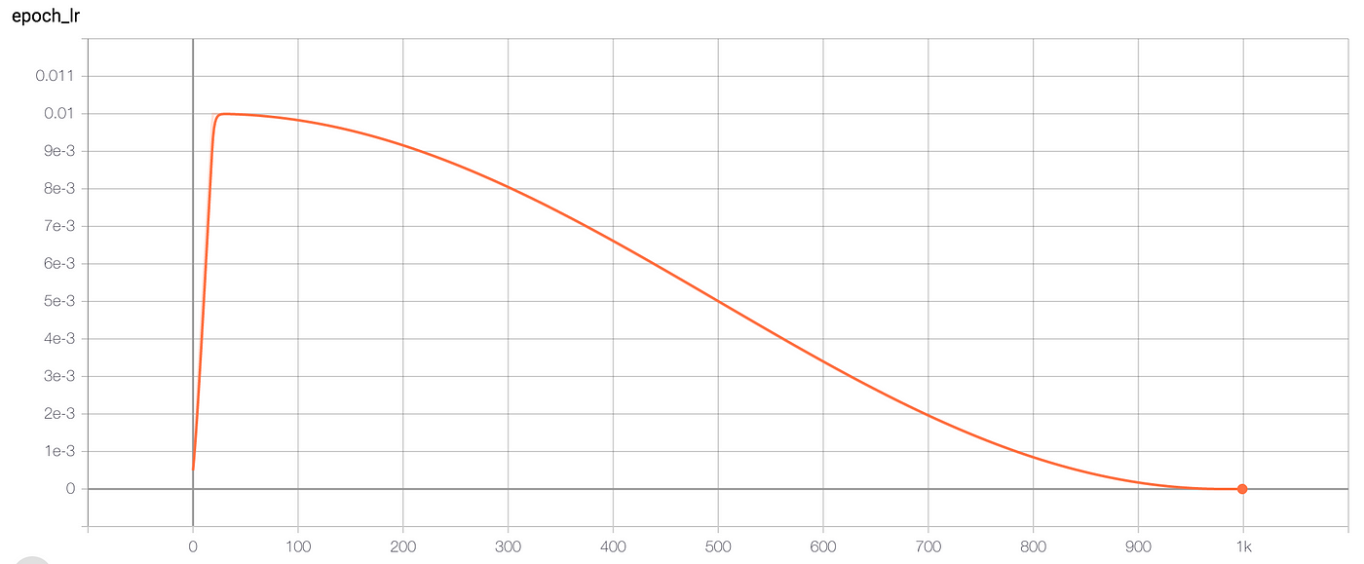
Learning Rate Schedular (Cosine Annealing)
Learningrate
Epoch
Notes:
where ηt​ is the learning rate at epoch t, ηmin​ and ηmax​ are the minimum and maximum learning rates, respectively, and Tcur accounts for the number of epochs performed since the last restart.

Slide 23
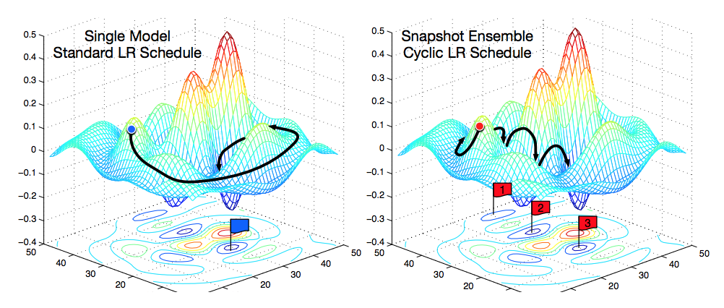
Cosine annealed warm restart learning schedulers
Notes:
Left: like in trainit, one warmup
Right: multiple decreasing restarts
https://www.ruder.io/deep-learning-optimization-2017/

Slide 24
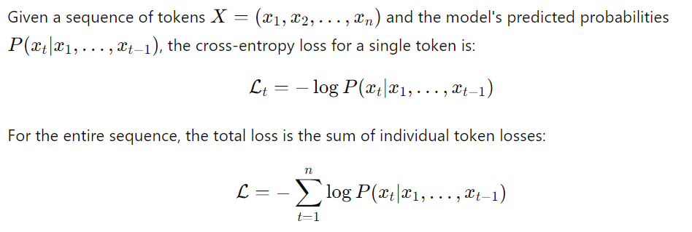
Loss
Notes:
Explain Mean Squared Error
Y_hat: prediction
Y: true value
\text{MSE} = \frac{1}{n} \sum_{i=1}^{n} (\hat{y}_i - y_i)^2

Slide 25
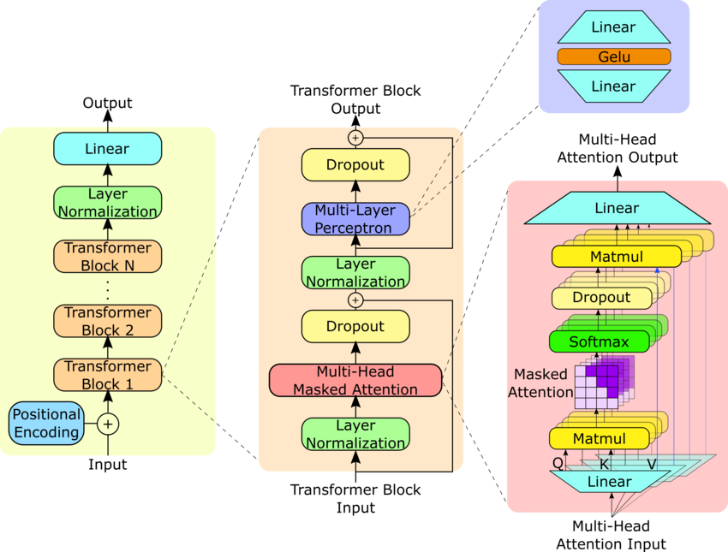
GPT-2 Model
Notes:
- **Self-Attention Mechanism:** Transformers use self-attention to weigh the importance of each word in a sentence relative to others, enabling the model to capture context and relationships between words.
- **Positional Encoding:** Since transformers process all words simultaneously (not sequentially like RNNs), they use positional encoding to retain the order of words in a sequence.
- **Layered Architecture:** Transformers consist of multiple layers of encoders (in models like BERT) or decoders (in models like GPT), where each layer refines the model’s understanding of the input.
- **Multi-Head Attention:** Transformers apply multiple self-attention heads in parallel, allowing them to focus on different parts of the input simultaneously.
**Feedforward Neural Networks:** After the self-attention mechanism, transformers use feedforward neural networks to process the output before passing it to the next layer.
https://www.researchgate.net/figure/GPT-2-model-architecture-The-GPT-2-model-contains-N-Transformer-decoder-blocks-as-shown_fig1_373352176

Slide 26
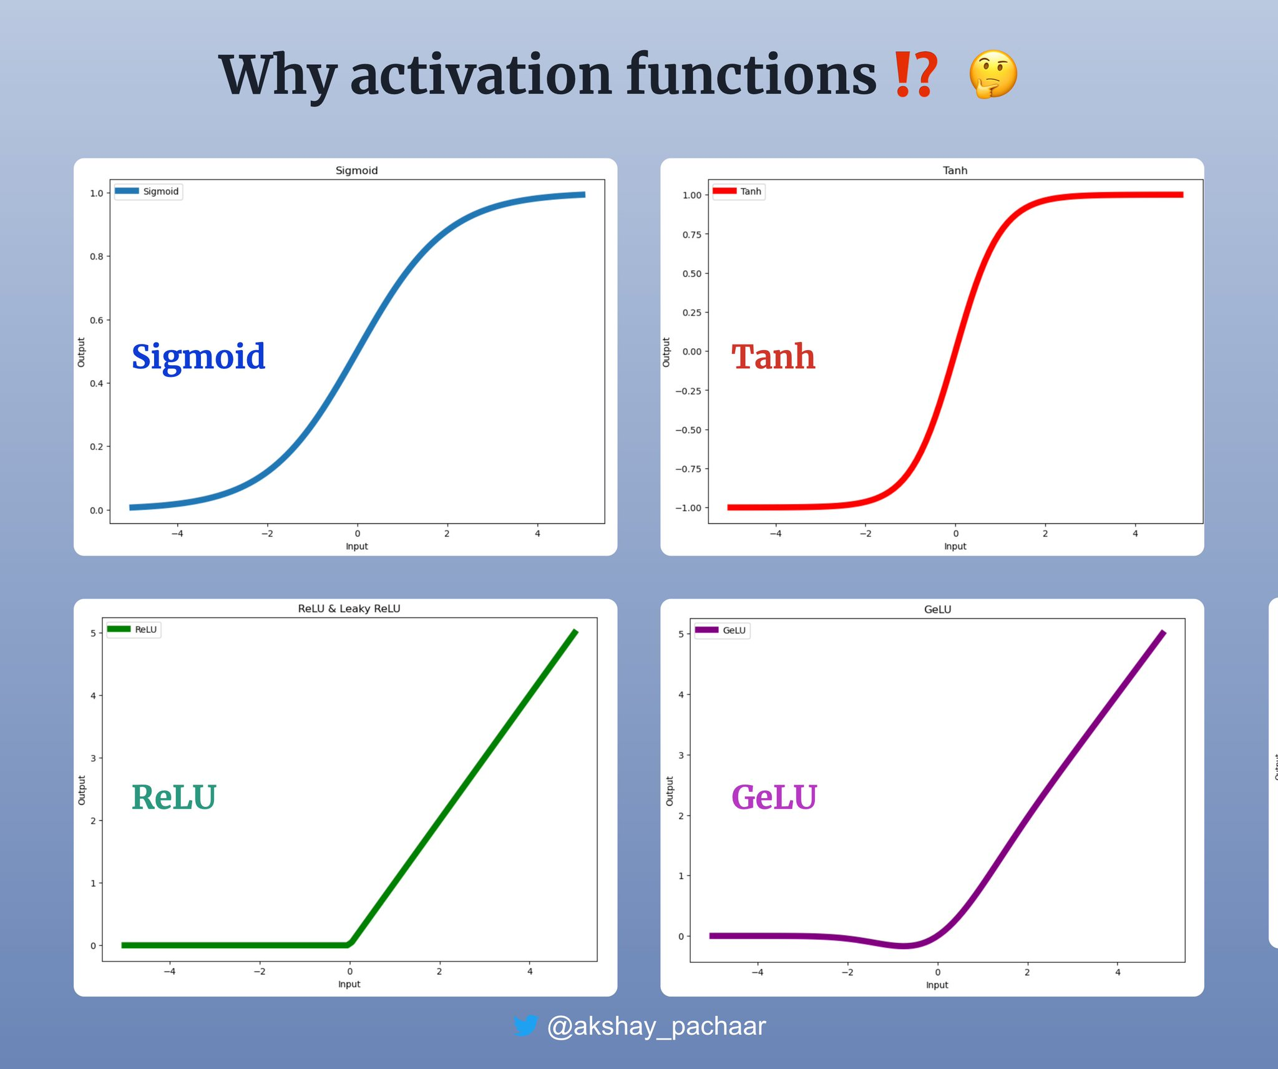

Slide 27
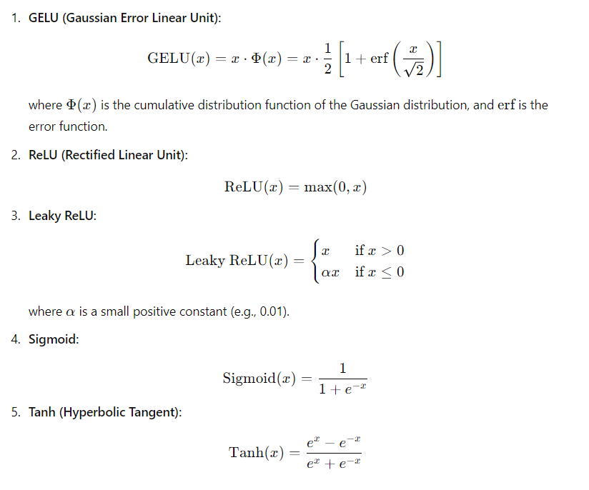
Notes:
Here are the formulas written out in plain text:
### Cumulative Distribution Function (CDF) for a standard normal distribution: Probabilty that Random variable X is below x
CDF(x) = (1/2) * [1 + erf(x / sqrt(2))]
### Error Function (erf):
erf(x) = (2 / sqrt(pi)) * integral from 0 to x of exp(-t^2) dt
These are the formulas expressed in plain text format without mathematical symbols.

Slide 28
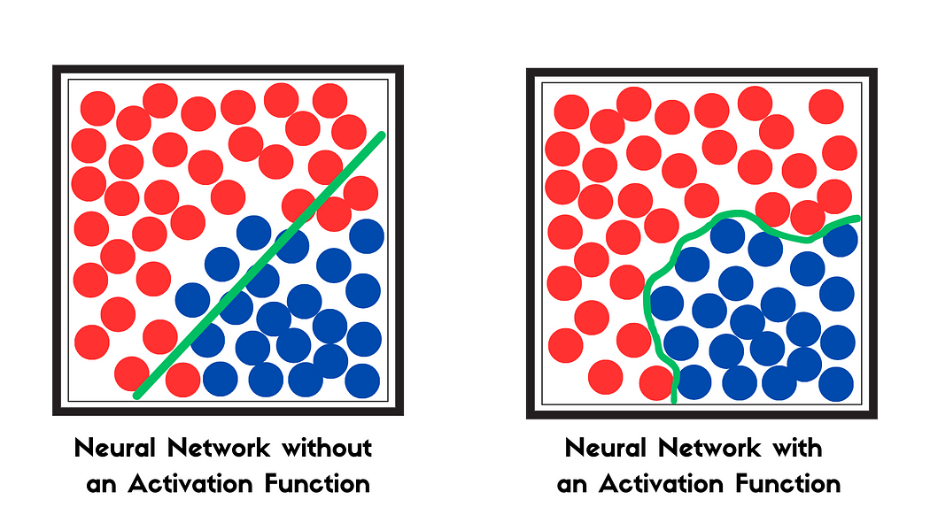
Activation Functions
Notes:
https://medium.com/@gauravnair/the-spark-your-neural-network-needs-understanding-the-significance-of-activation-functions-6b82d5f27fbf

Slide 29
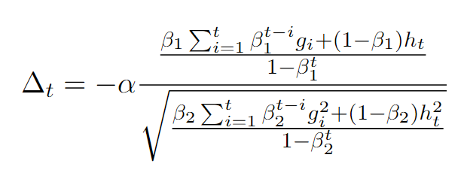
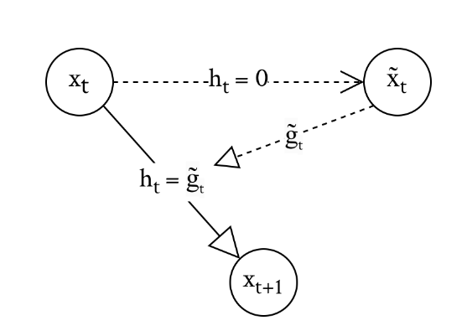
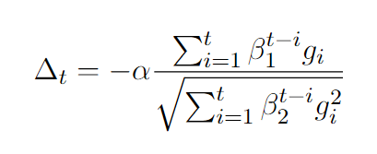
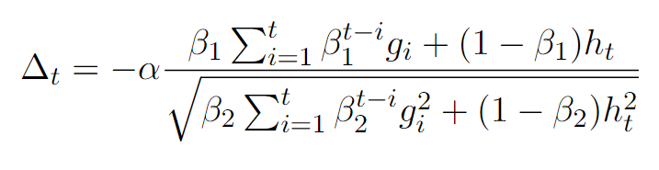



POC OFTRL bias correction:

Slide 30
Image-Sources
Slide 2: https://www.vecteezy.com/photo/26263888-cute-little-golden-retriever-dog-on-white-background-generative-ai
Slide 3: https://arxiv.org/pdf/2209.05451
https://miro.medium.com/v2/resize:fit:1400/0*yosQ9u0cmtipniHZ
https://machinelearningmastery.com/wp-content/uploads/2021/10/transformer_1.png

